Slide 1
Industrial Robot Arm
Industrial Track

Slide 2
Project Plan
Teamwork
The way we work will be collective , The team will work together in all tasks and in parallel to conserve time, exchange experiences and skills, and preserve time.
Our industrial robot arm is to help laboratories, and factories to increase production by carrying materials and small products.

Slide 3
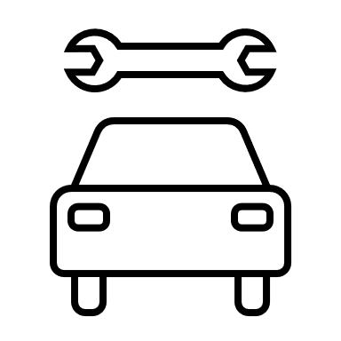



Task Distribution
Industrial
Mechanics
Electrics
AI
IOT
Allocate the tasks and responsibilities for the team members, determine the amount of time required, testing and reviewing the work.
Responsible for the
production line, taking
measurements and
designing the arm.
Figuring out the needed
electronic devices and
how to program them and
compute the degree of
efficiency.
Apply the sensors in the
arm so it recognizes its
surroundings and doesn’t
hurt anyone.
supervise the development of the
devices or sensors themselves, programming the software that allows us to
control the arm.

Slide 4
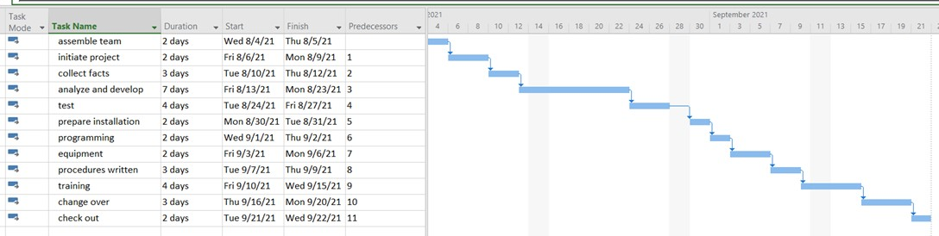
Timeline

Slide 5
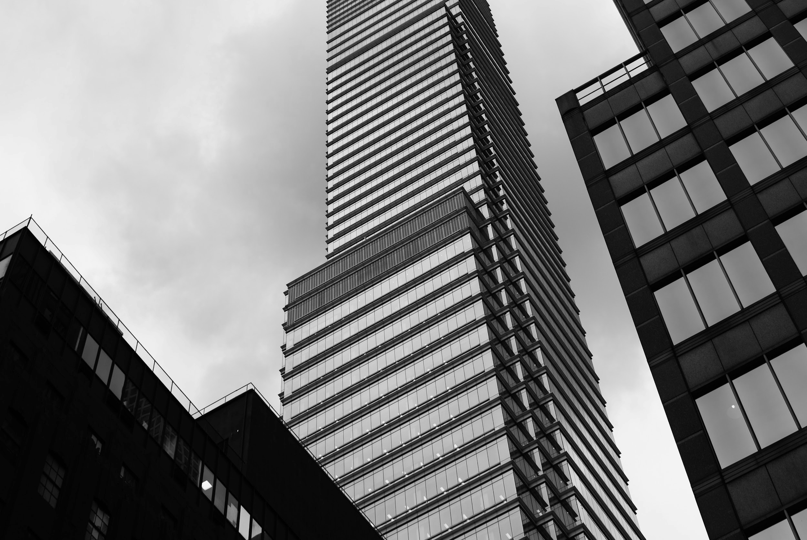
Introduction
Robotic arms are generally made to simulate a human arm. This is achieved by giving it 7 various segments each part giving it more motion.
Robot arms will often have: The above stated 7 various segments bound together with 6 joints.
Programmable which gives the user a choice to rotate each motor at various times.
Have multiple attachments, meaning a robot can have claw, drill, welder, spray gun etc.
Various sensors to perform specific tasks.

Slide 6
Modelling
01.
PACKEGS
03.
ASSEMBLY
02.
Software
04.
Production Line
Cutting tool ,3D print and CNC
Box
Mechanical
App & Website

Slide 7
Our Team
Idrees Yahya
Naif Alzahrani
IE, Team Leader
ME, Team Member
Abdulrahman Makkawi
Annas Almagdawi
EE, Team Member
Software and IoT, Team Member
Reem Alhamed
Ahmad Sami
AI and Robotics, Team Member
AI and Robotics, Team Member

Slide 8
Thanks!
Smart Methods
Summer Training Internship
@Smart_Methods
Please keep this slide for attribution.

